Slide 1
Information Architecture Wireframe Storyboard
Assignment 1
Wildan Luqmanul Hakim

Slide 2
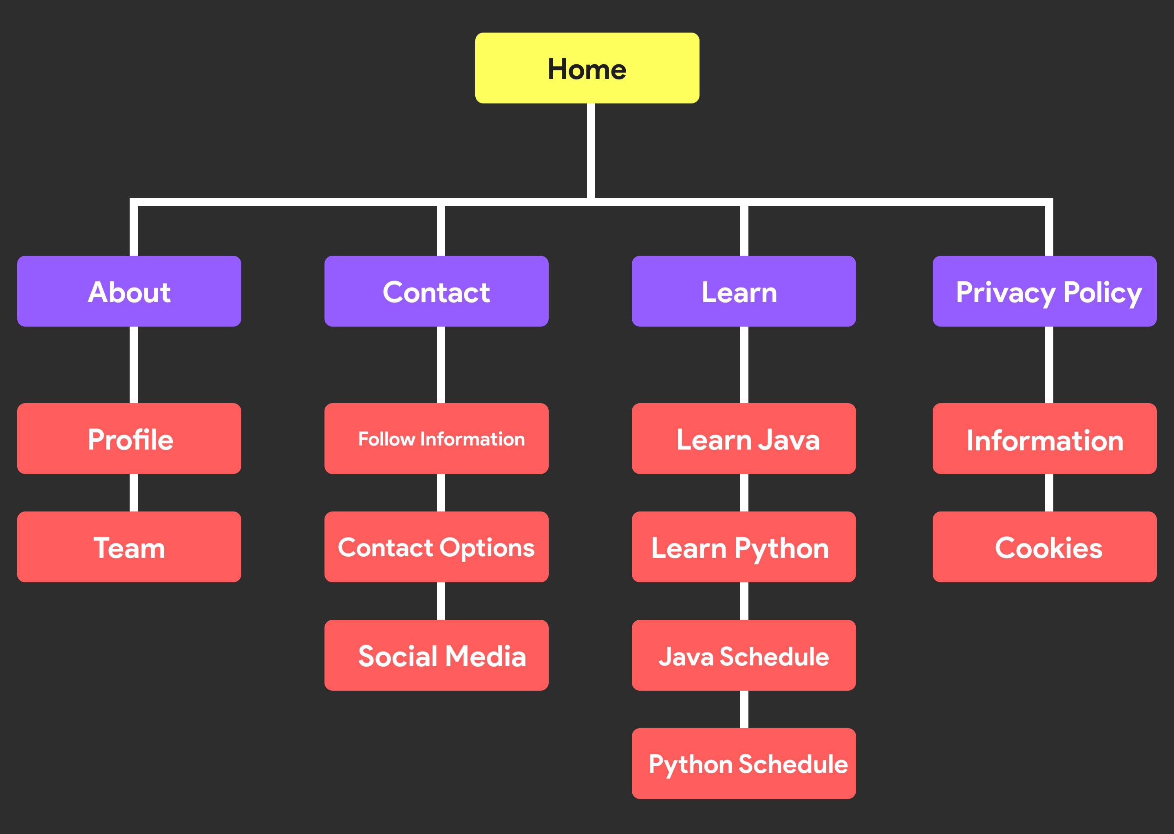
Information Architecture

Slide 3
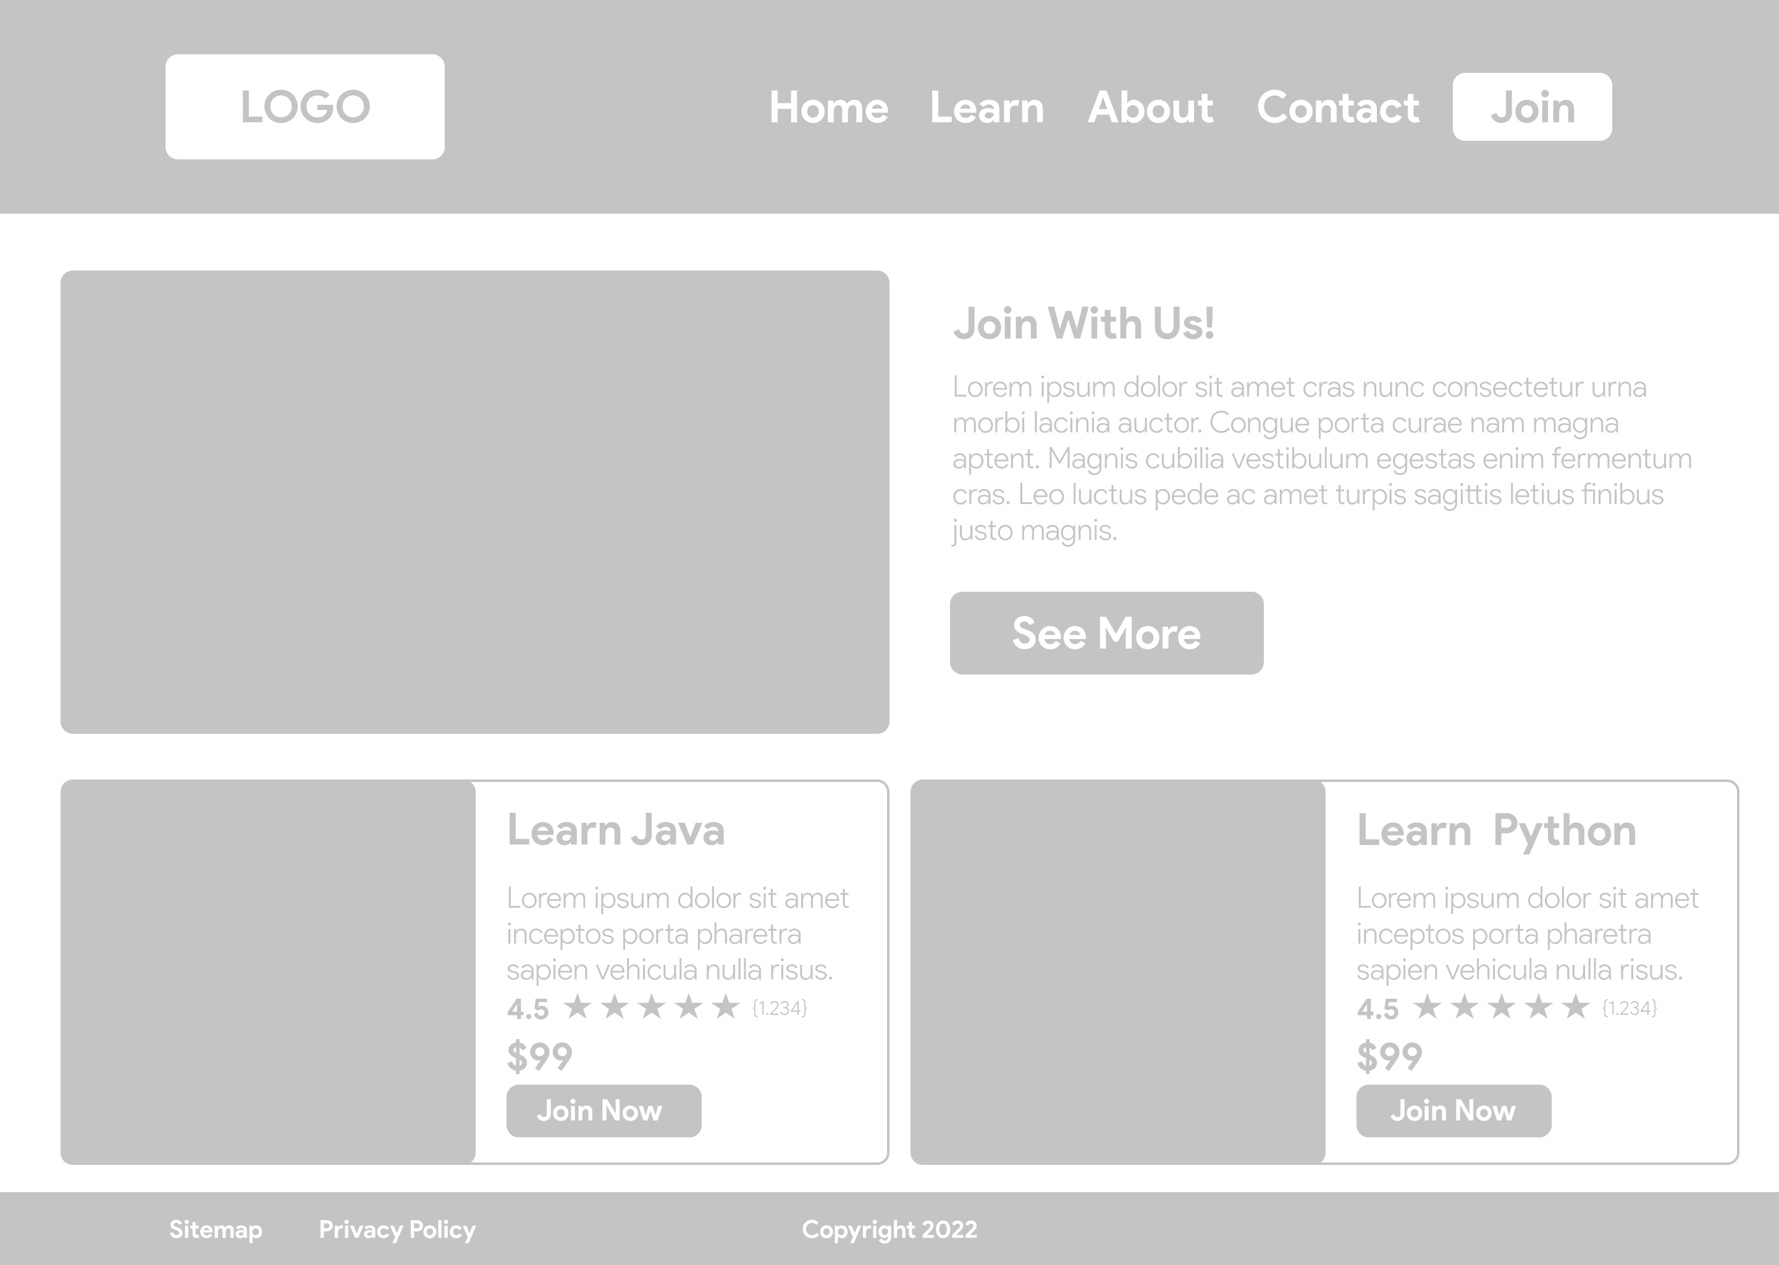
Storyboard and Wireframe
Home Page
Home Page >Details Page > Schedule Page >
About Page > Contact Page > Sitemap Page >
Privacy Policy Page

Slide 4
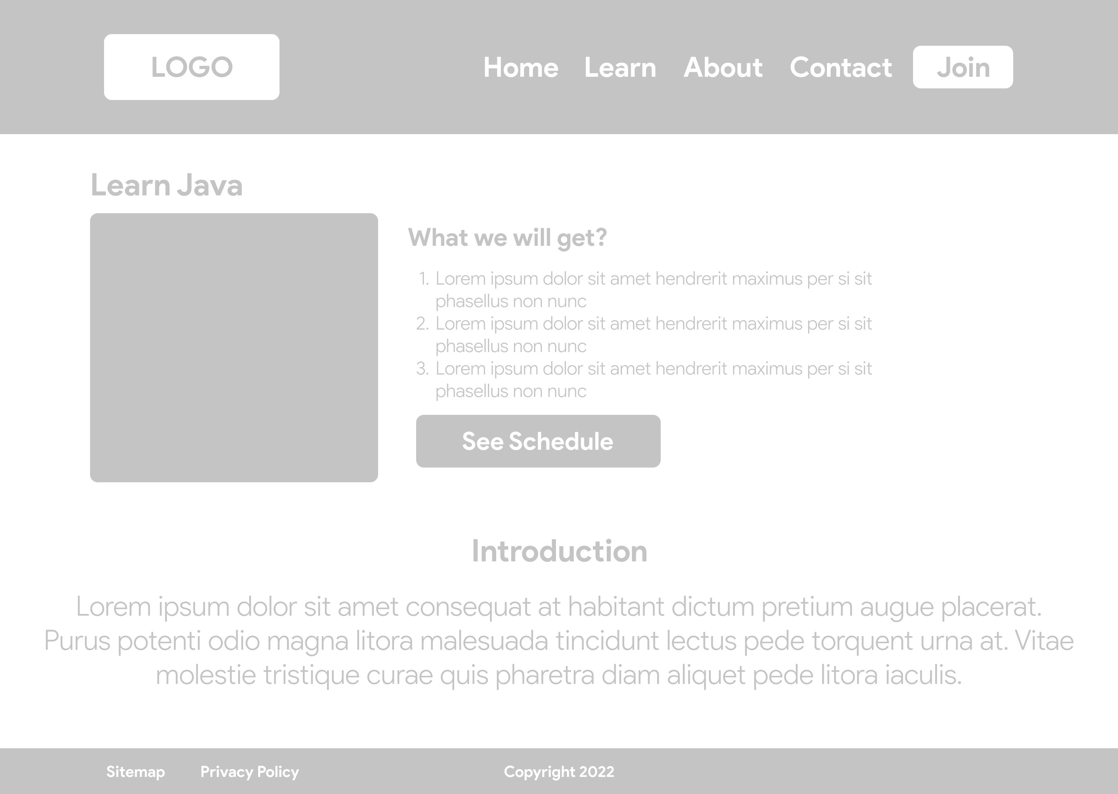

Storyboard and Wireframe
Details Page
Learn Java Page
Learn Python Page

Slide 5
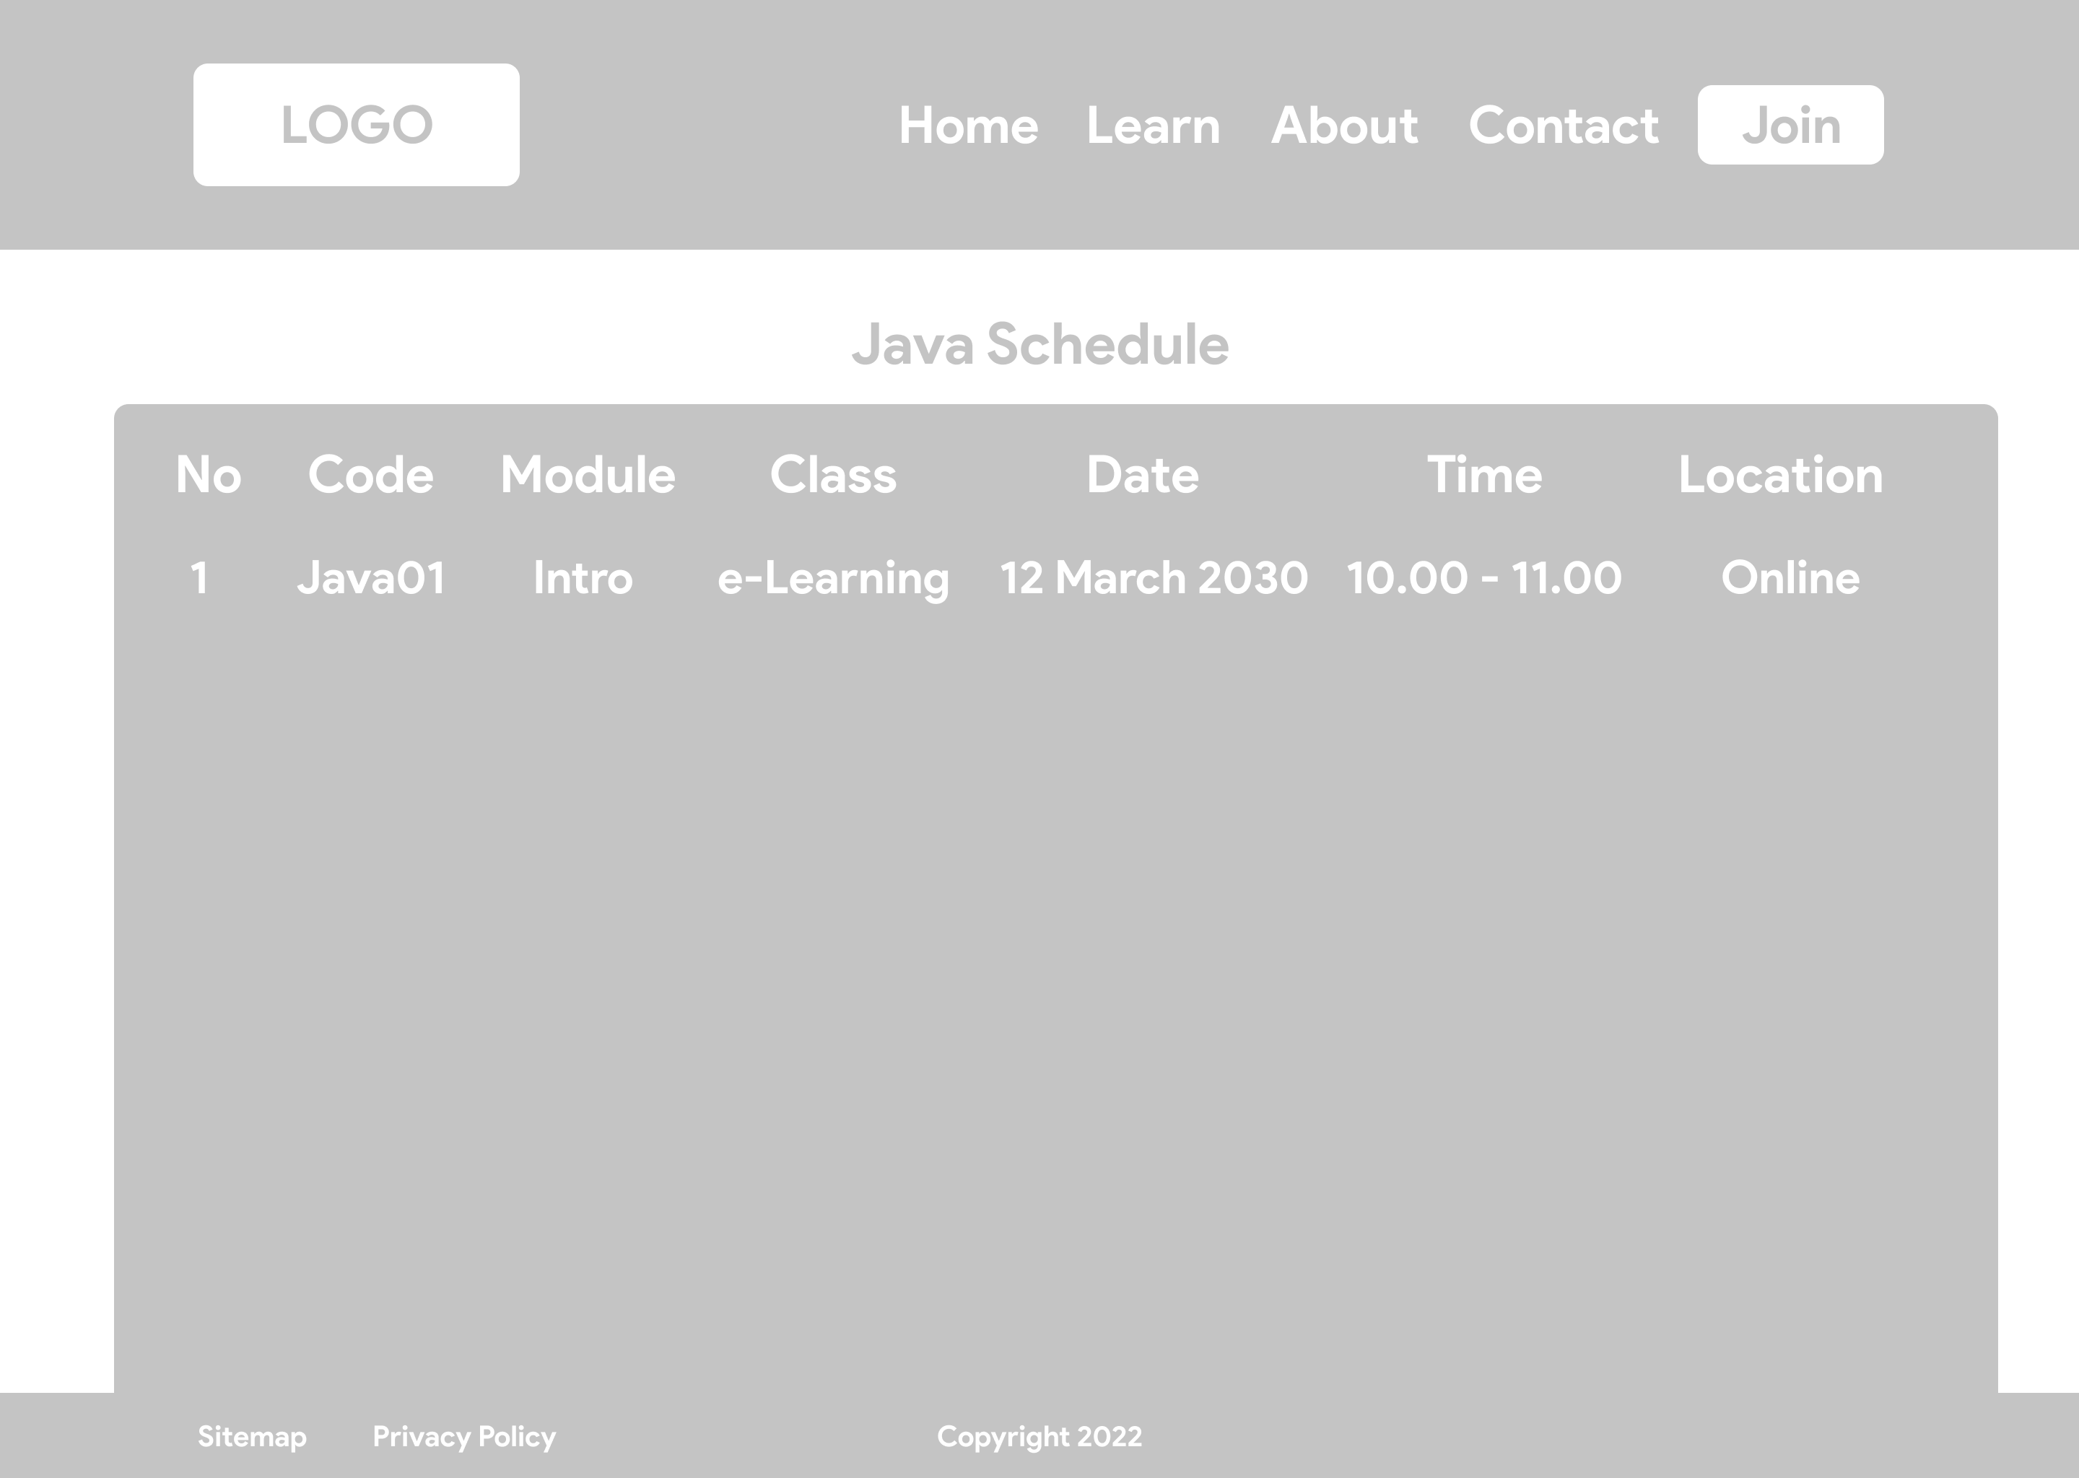

Storyboard and Wireframe
Schedule Page
Java Schedule Page
Python Schedule Page

Slide 6
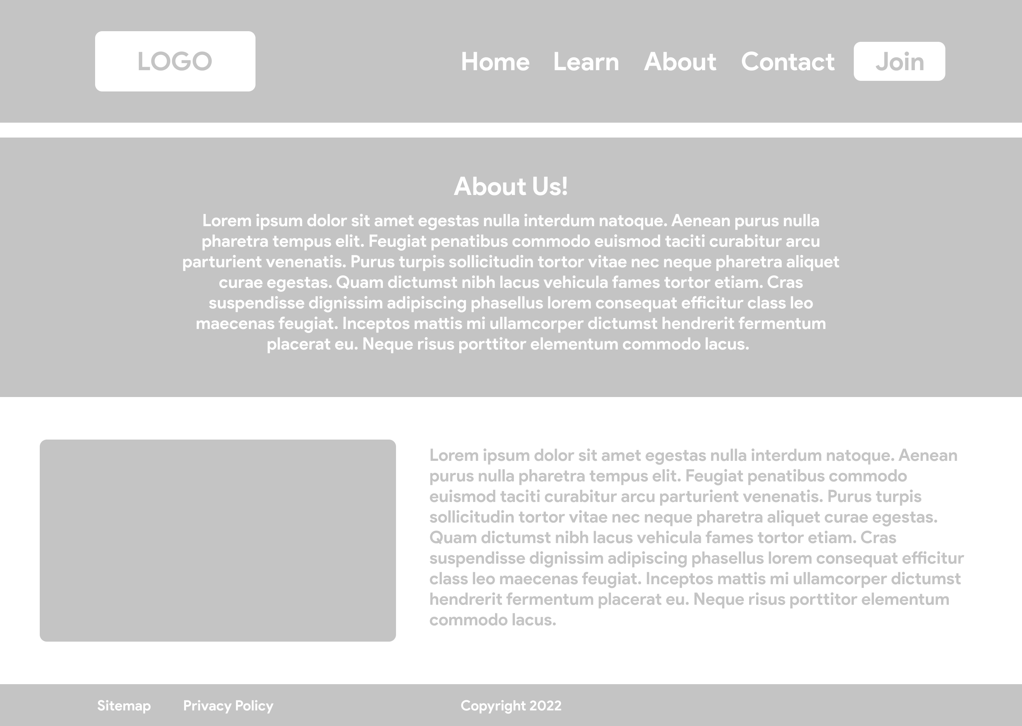
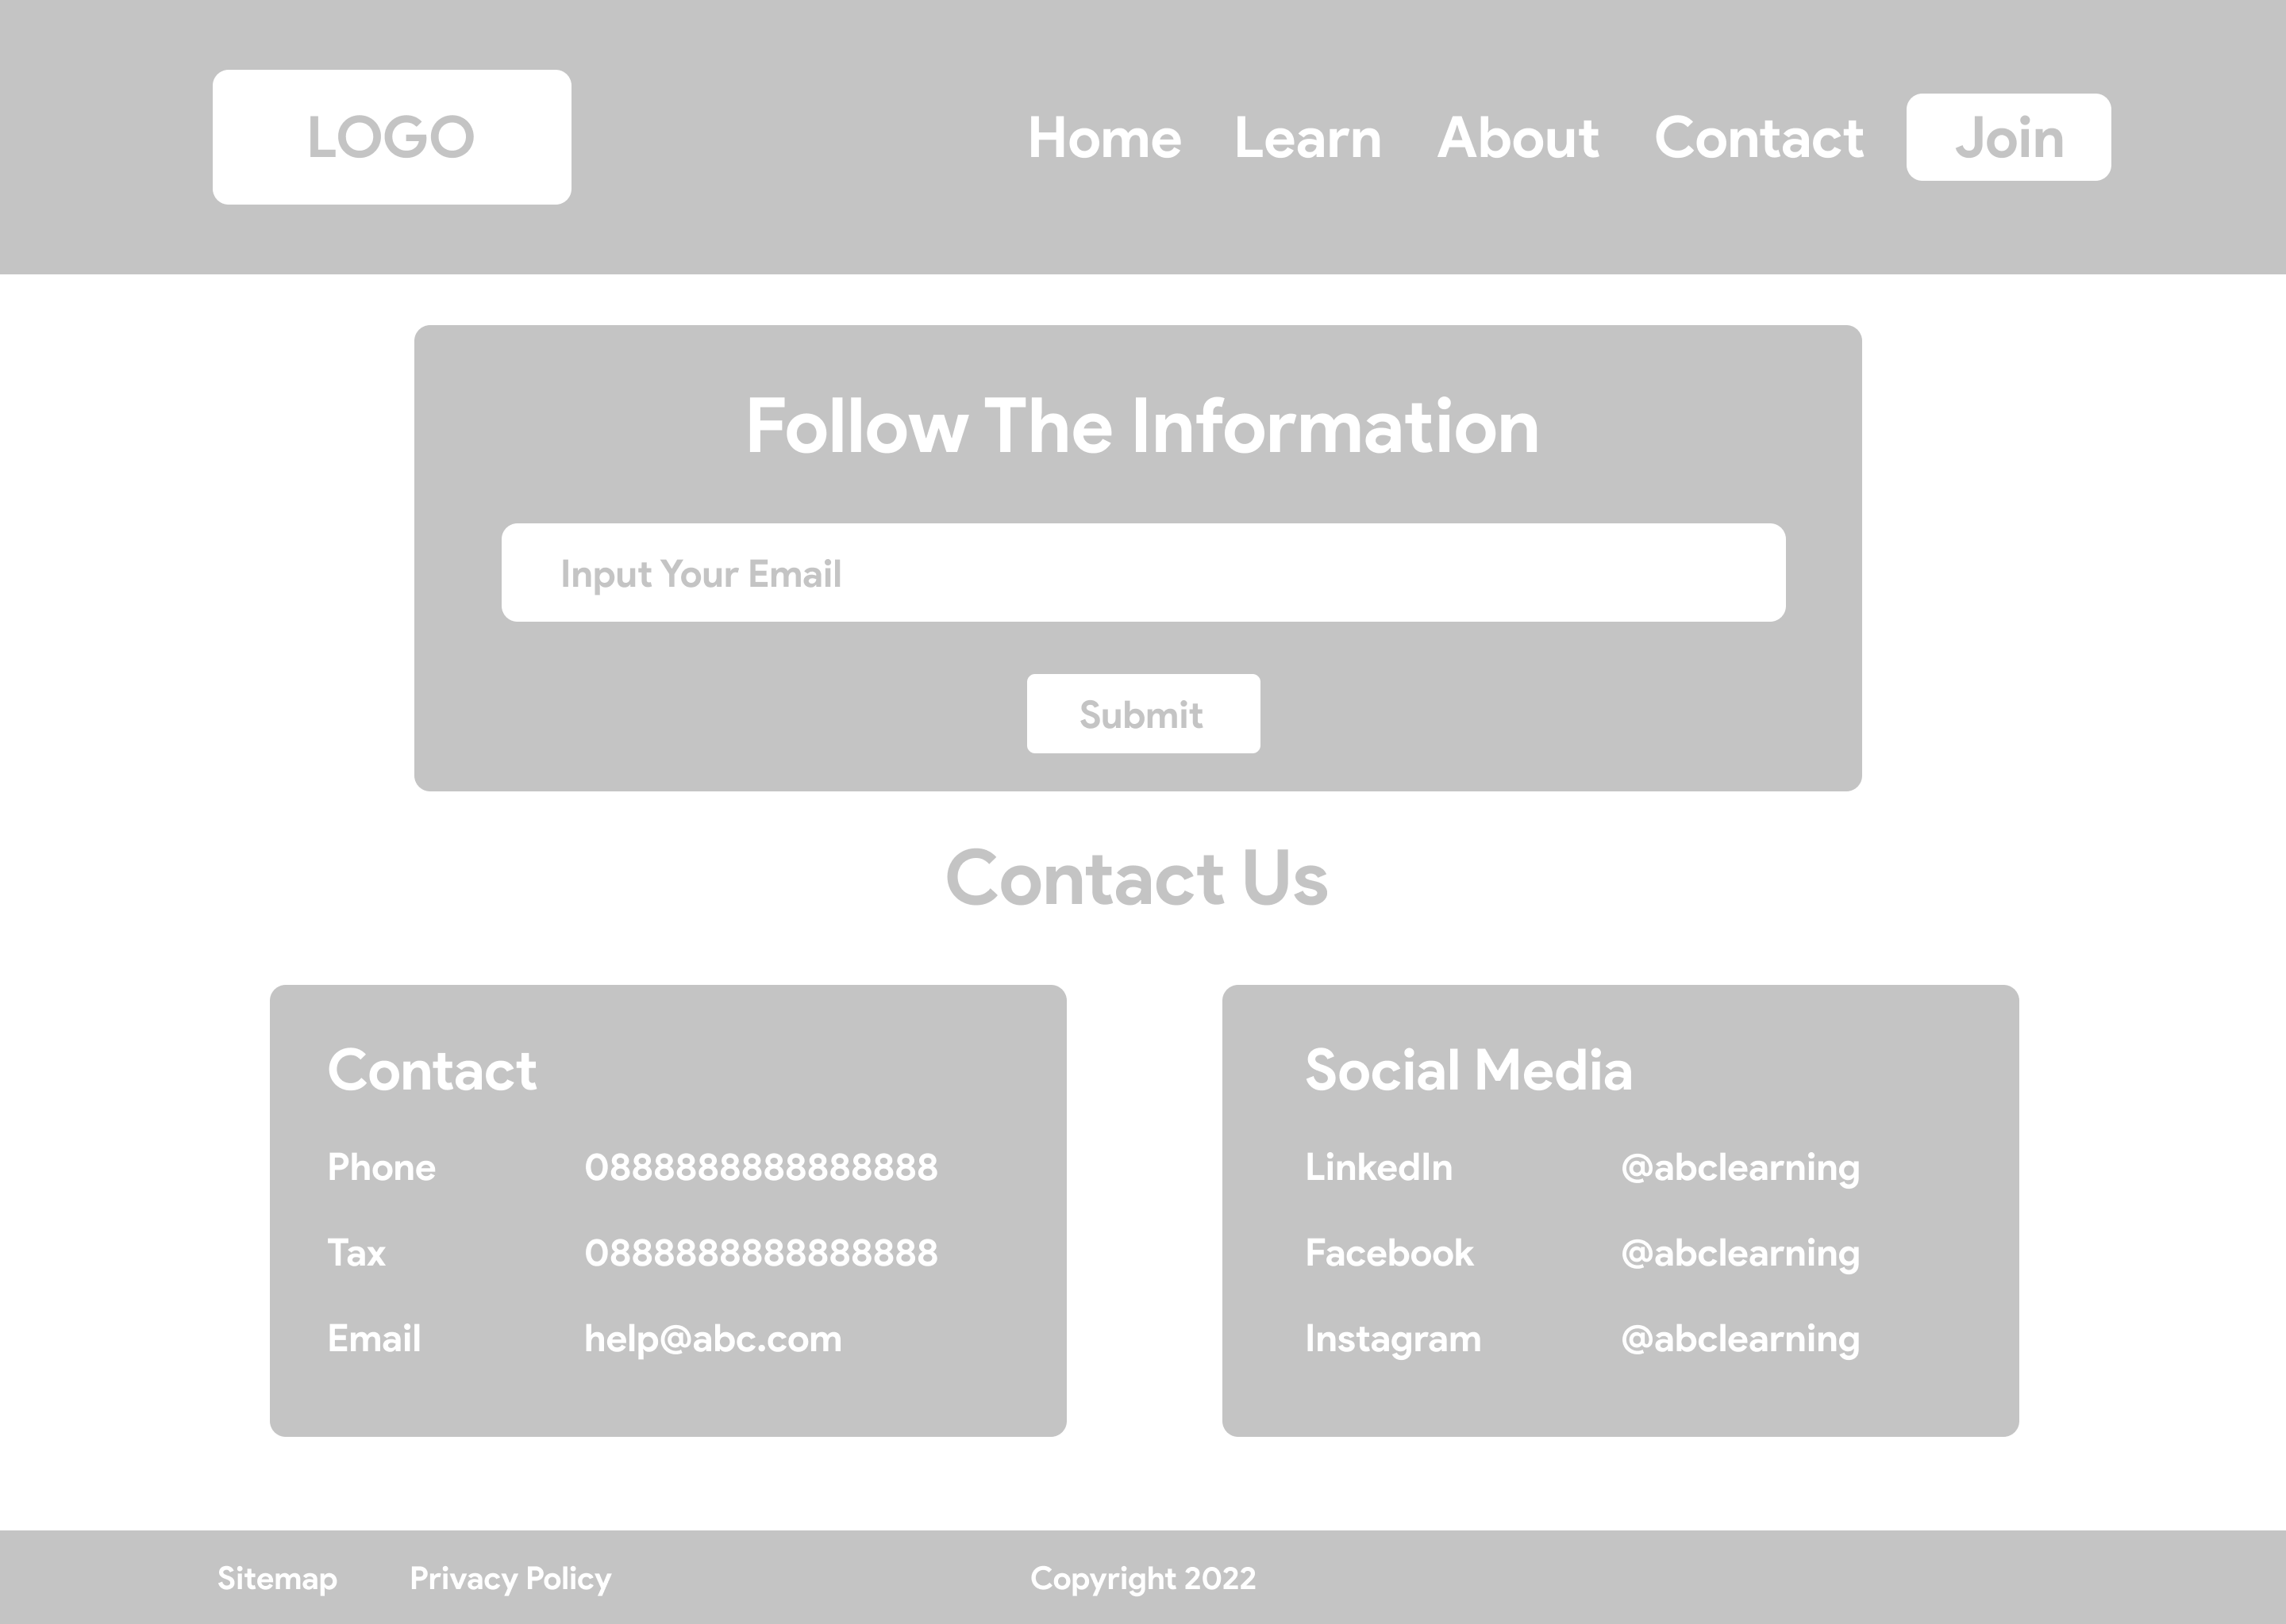
Storyboard and Wireframe
About Page
Contact Page

Slide 7
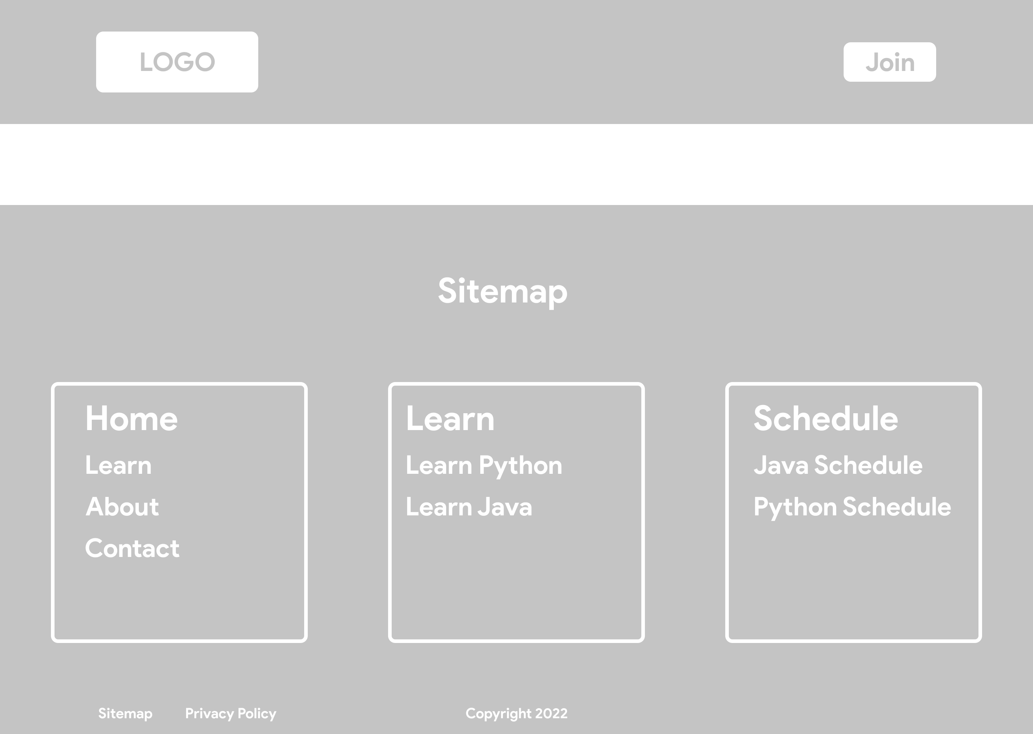
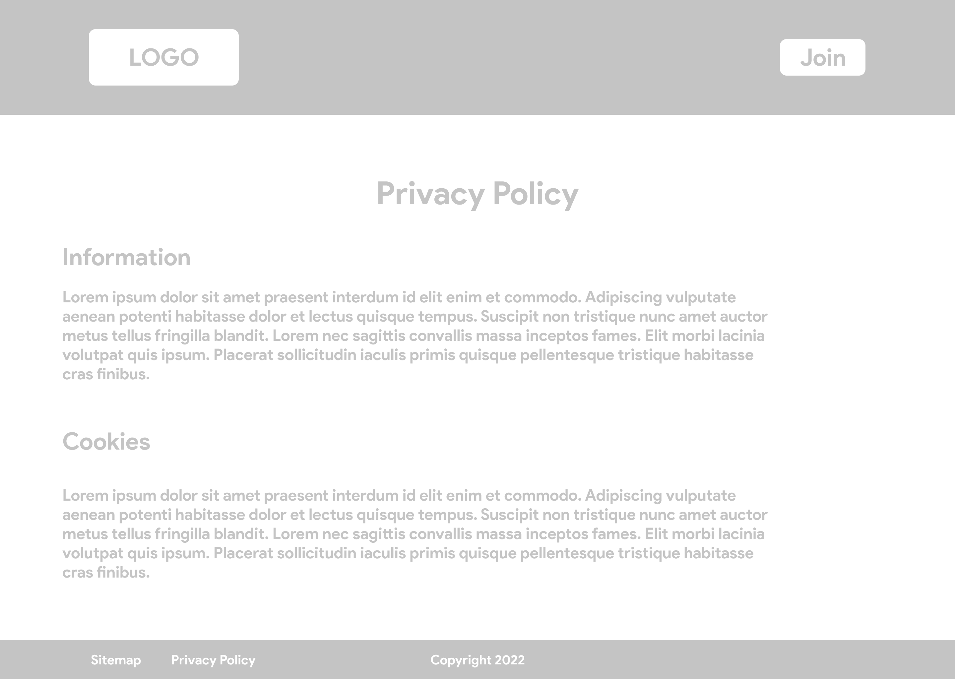
Storyboard and Wireframe
Sitemap Page
Privacy Policy Page

Slide 8
Thank You

